Slide 1
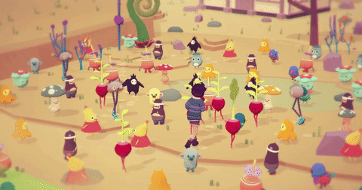
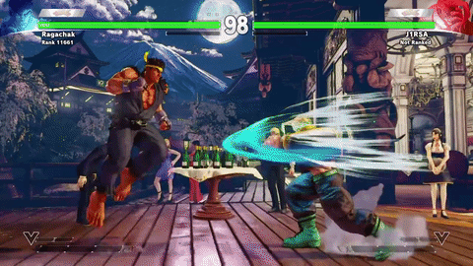
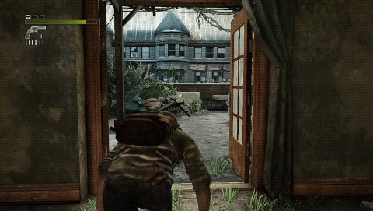
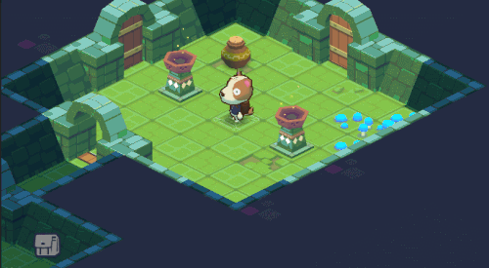
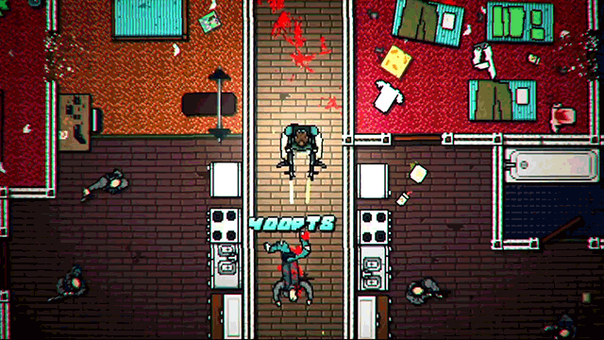
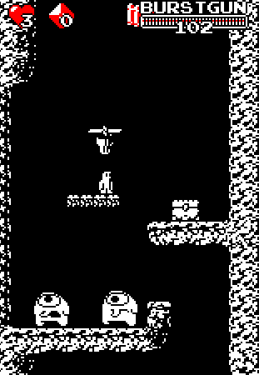
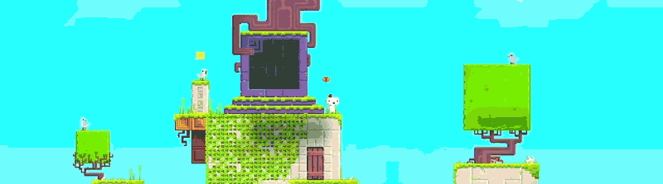
Welcome to GameDev0

Slide 2
Why we’re here
Notes:
Videogame development is extremely accessible today

Slide 3
Here's what u will learn
Art
Code
Sometimes the limit is your imagination
Modelling a world
Notes:
Basically games can be broken down into 2 parts
ART
-visuals
-sound
-writing
Yes I treat games as art so that’s how you know I'm serious
CODE
-game logic
The main thing is changing your perception of games. If you want to be successful in gamedev then you have to shift your perspective from that of someone who plays games to someone creates games.
These two processes are similar but aren’t the same experience
Later we’ll get into what a game is

Slide 4
What is a game?

Slide 5
Mechanics inform genre
Genres blend together but they are typified by certain mechanics
FPS
MOBA
3D Platformer
Rogue-like
2D Platformer
Sandbox
RPG
These genre names imply a lot about a games mechanics
Notes:
Games are generally described by their genre
It doesn’t hurt to know what you are trying to make
Exceptions;
Portal is fps but u don’t shoot
Genres blend together and aren’t solid but they are typified by certain mechanics

Slide 6
Mechanics are rule sets
If(!dead){
}
Rule sets are similar to the rules of a real life game
But everything has to come down to a true or false question
Building a complex ruleset requires a lot of thought!
If(canJump){
}
If(Player.InvCheck(“lamp”){
}

Slide 7
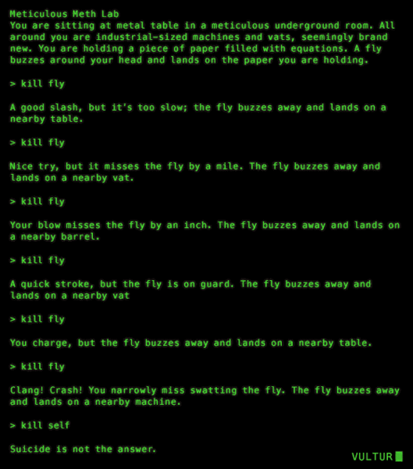

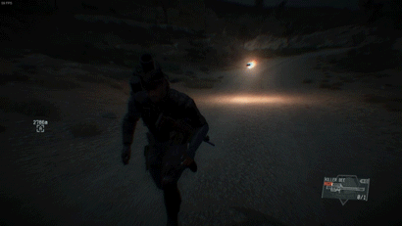
Visual Presentation
Notes:
Sometimes the mechanics inform the art style.
Sometimes your limitations inform the art style

Slide 8
Social media!!!!!!!!!!
Facebook page
Facebook Group

